Slide 1

Stage 5 Hillary Ensues Course Designer: Eric Beerbaum
Carbine: N/A Handgun: 44
The start position is both hands touching upper mark. Handgun is loaded and holstered.
On the audible start signal, engage all targets with Handgun only from within the shooting area. Everything behind the front fault line is the shooting area.

Slide 2
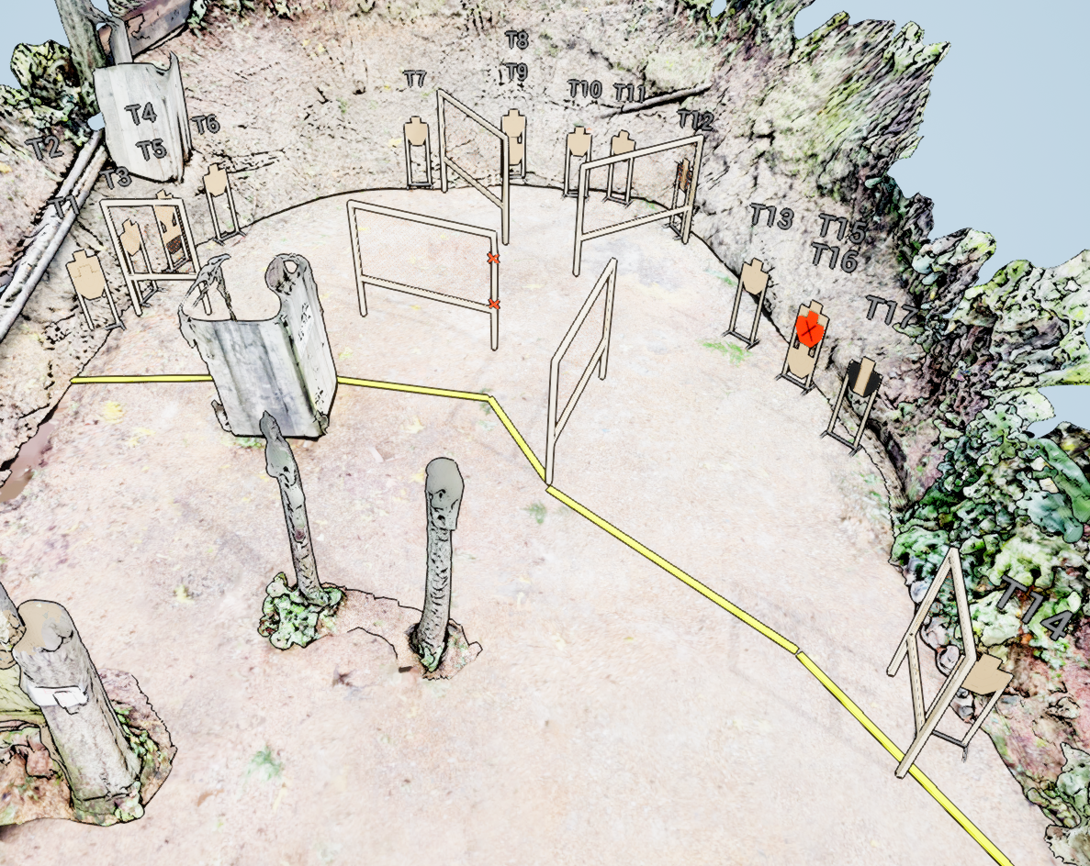
 | Stage 5 Hillary Ensues Course Designer: Eric Beerbaum

